Slide 1
RESCUE
Resilience Co ordination under Emergencies
TEAM THE POTTERHEADS
NIKHIL KALRA (001389947)
PURVANG JAYESH THAKKAR (001387983)
SHASHANK VAIDYA (001388214)

Slide 2
Resilience involves identifying and nurturing the capacity to cope with the myriad stresses that life inevitably brings. It involves identifying and nurturing the capacity for governments, metro-regions, communities, and private-sector entities to understand and better manage increasingly interconnected and interdependent systems that elevate the risk of wide-reaching and cascading failures when placed under stress.
The purpose of this application is to organize and manage resources and responsibilities for dealing with all humanitarian aspects of emergencies, in particular preparedness, response and recovery in order to lessen the impact of disasters.
The enterprises need to work in unity to ensure the victims are provided with the necessary amenities and bring them to safety. This is achieved by the application that would help prioritize and manage the responsibilities.

Slide 3
HOW IS OUR APPLICATION DIFFERENT FROM OTHERS APPLICATIONS
Google api * which would allow the nearest organization to serve the victims
An email and a text notification to the volunteers who registered through this application to volunteer for the effected sites .this is done using an email api* and email to phone api*.
Graphical representation displaying numbers after effects of the event

Slide 4
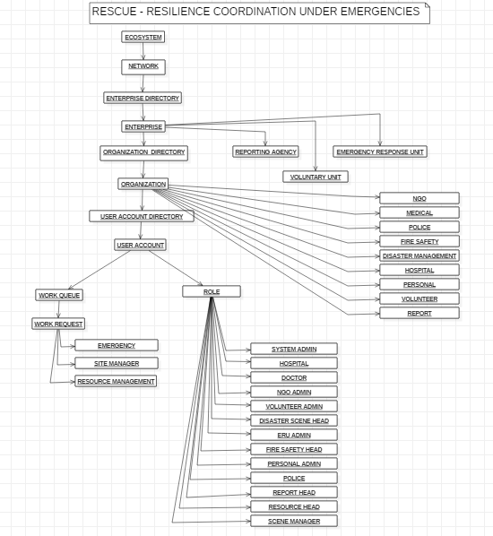

Slide 5
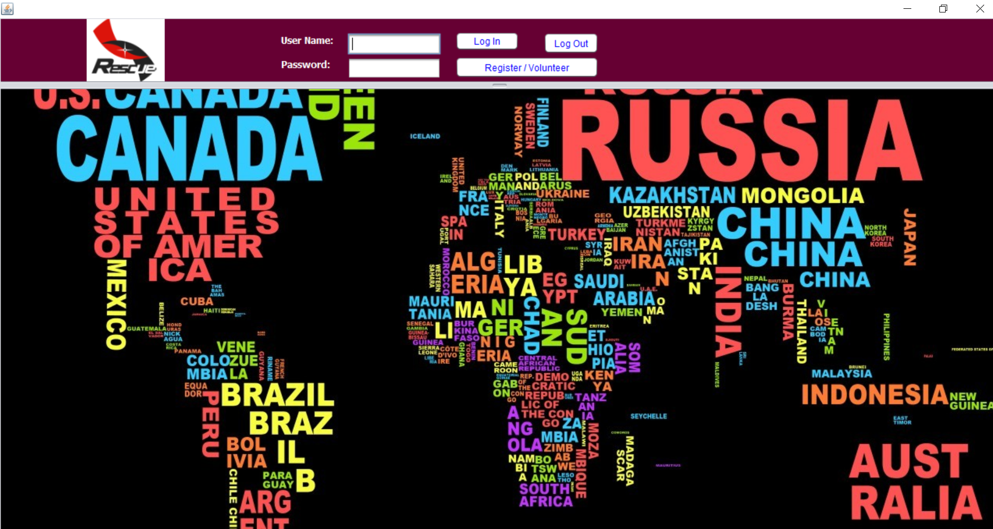
HOME PAGE

Slide 6
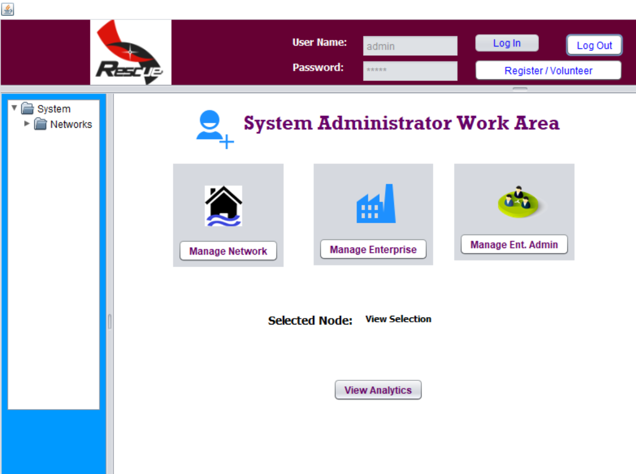
ADMIN PAGE

Slide 7
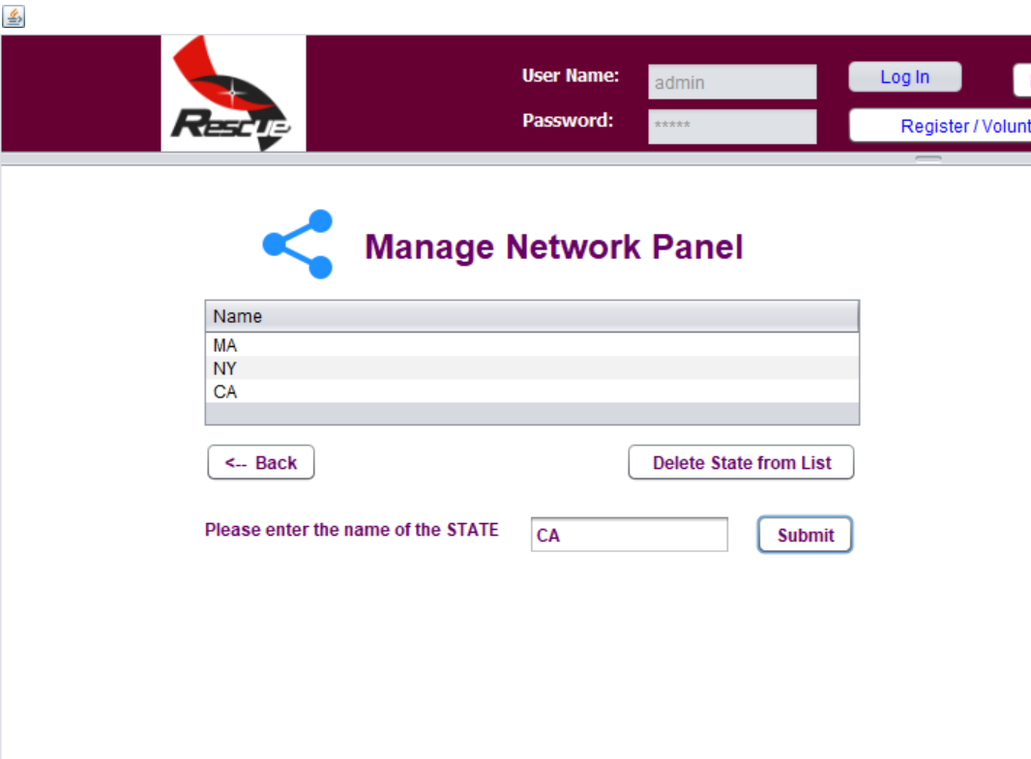
MANAGE NETWORKS

Slide 8
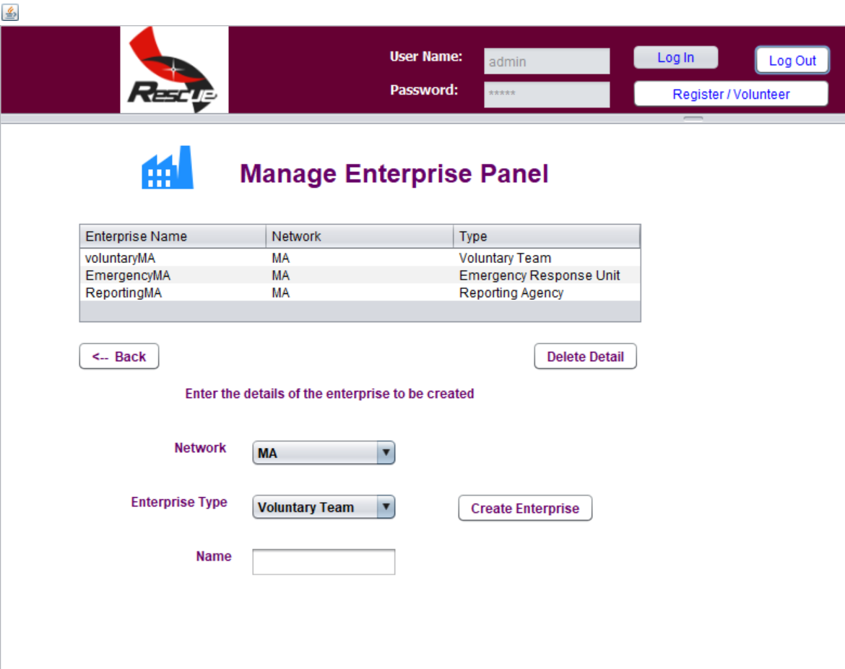
MANAGE ENTERPRISES

Slide 9
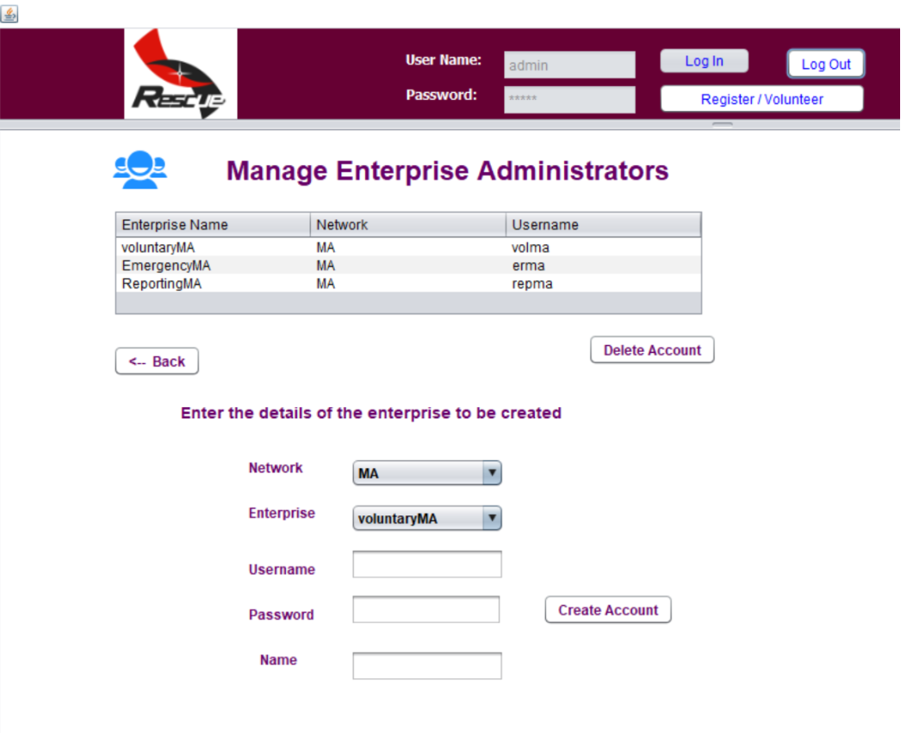
MANAGE ENTERPRISE ADMIN

Slide 10
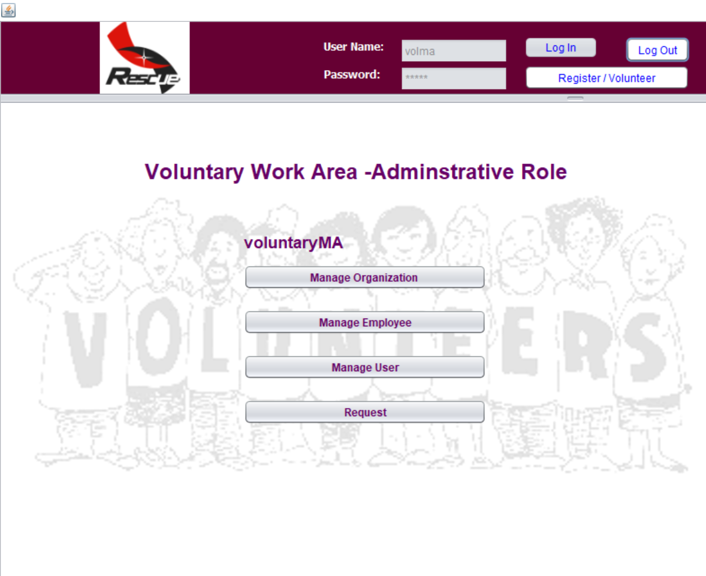
VOLUNTARY ENTERPRISE ADMIN PAGE

Slide 11
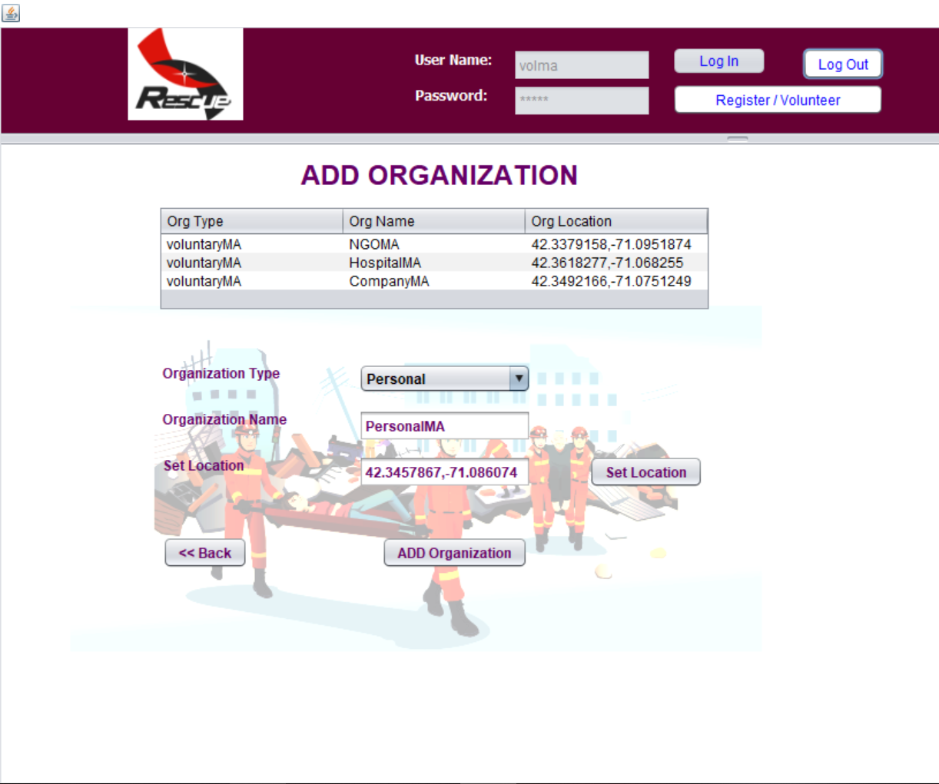
VOLUNTARY ENTERPRISE ADD ORGANIZATION

Slide 12
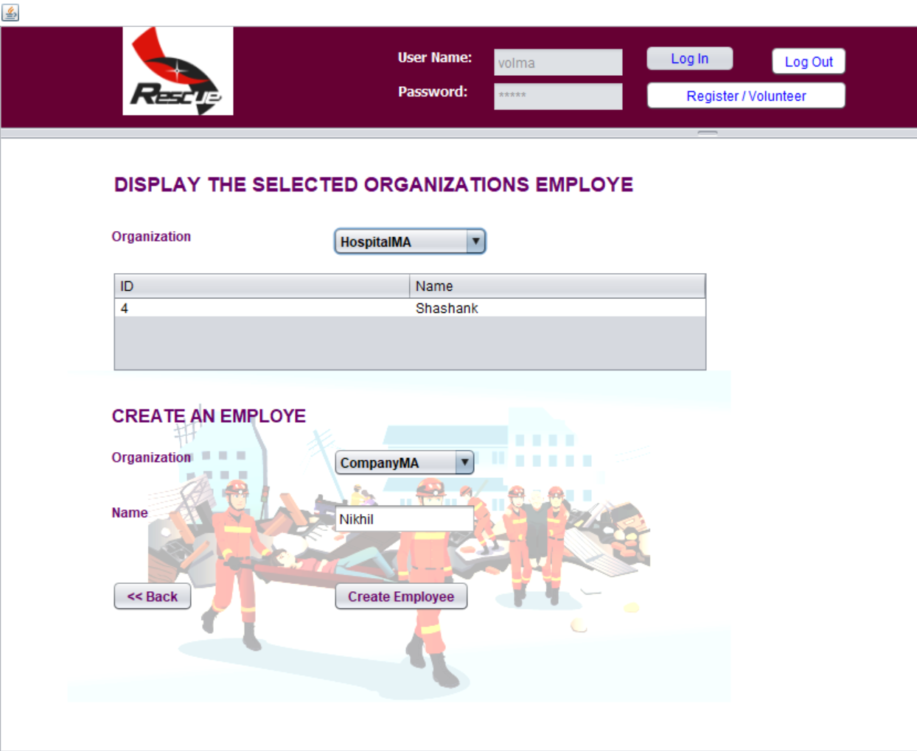
Voluntary Enterprise Employee Management

Slide 13
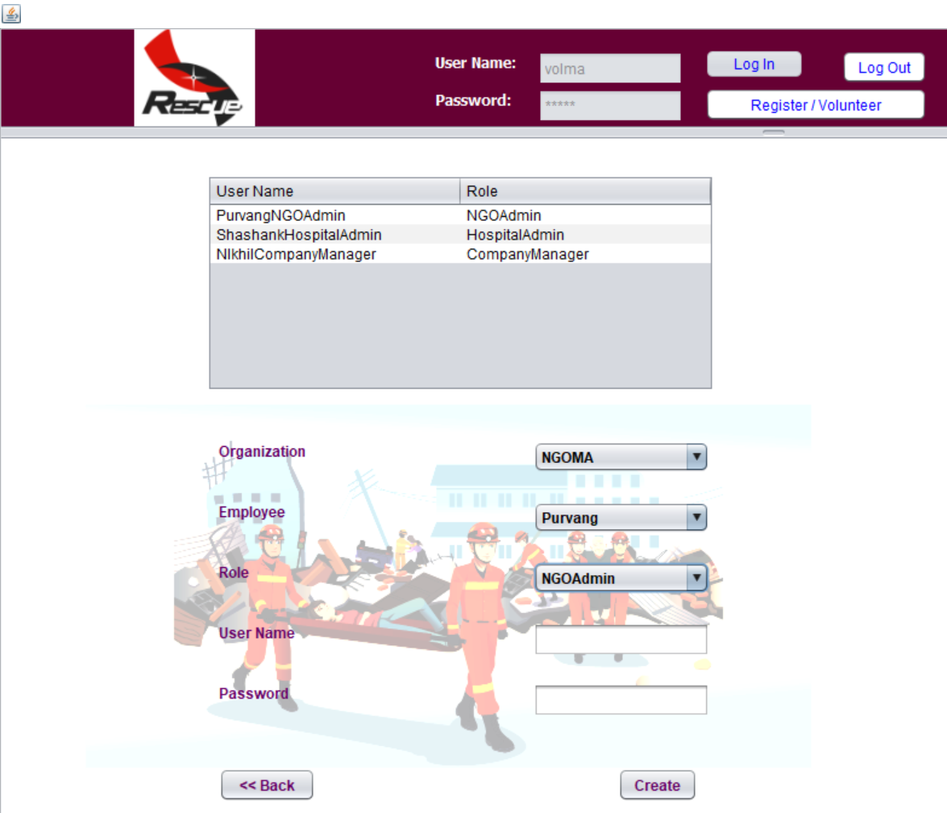
VOLUNTARY ENTERPRISE MANAGE USER

Slide 14
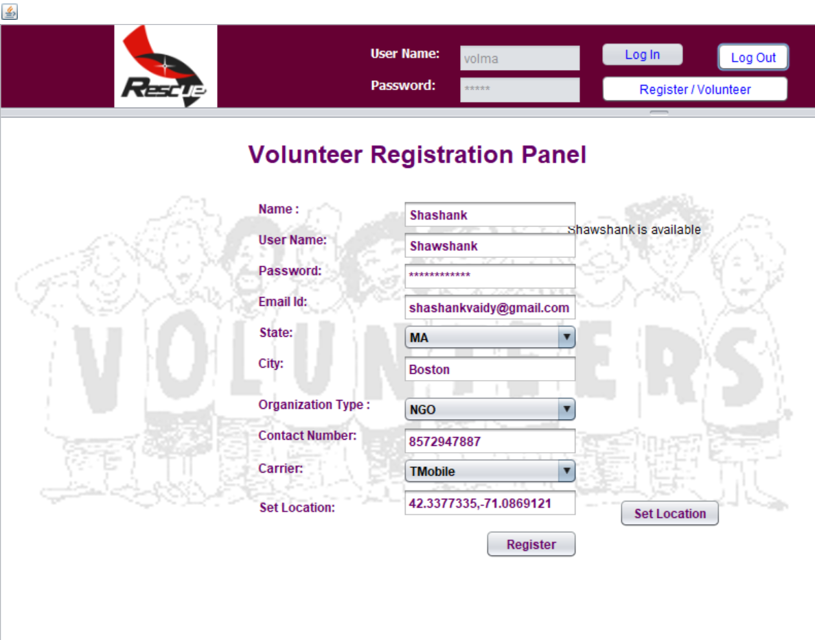
VOLUNTEER REGISTRATION PAGE

Slide 15
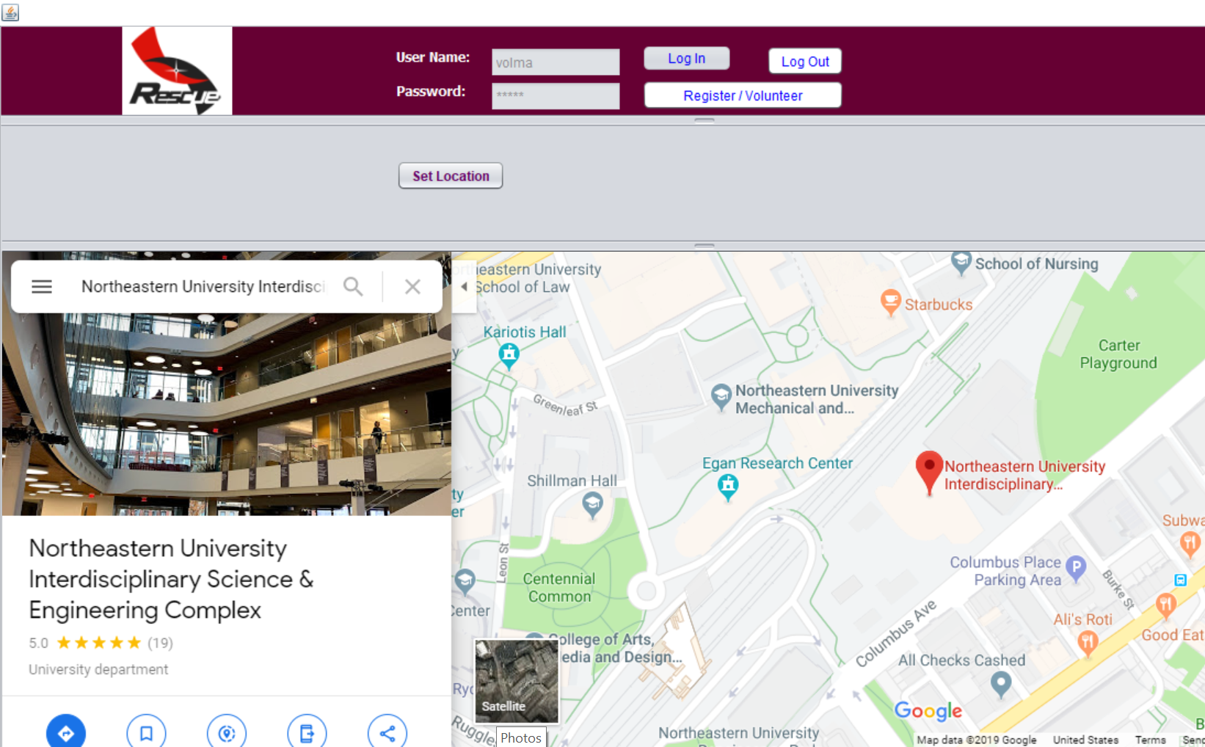
LOCATION CHOSEN BY THE VOLUNTEER

Slide 16
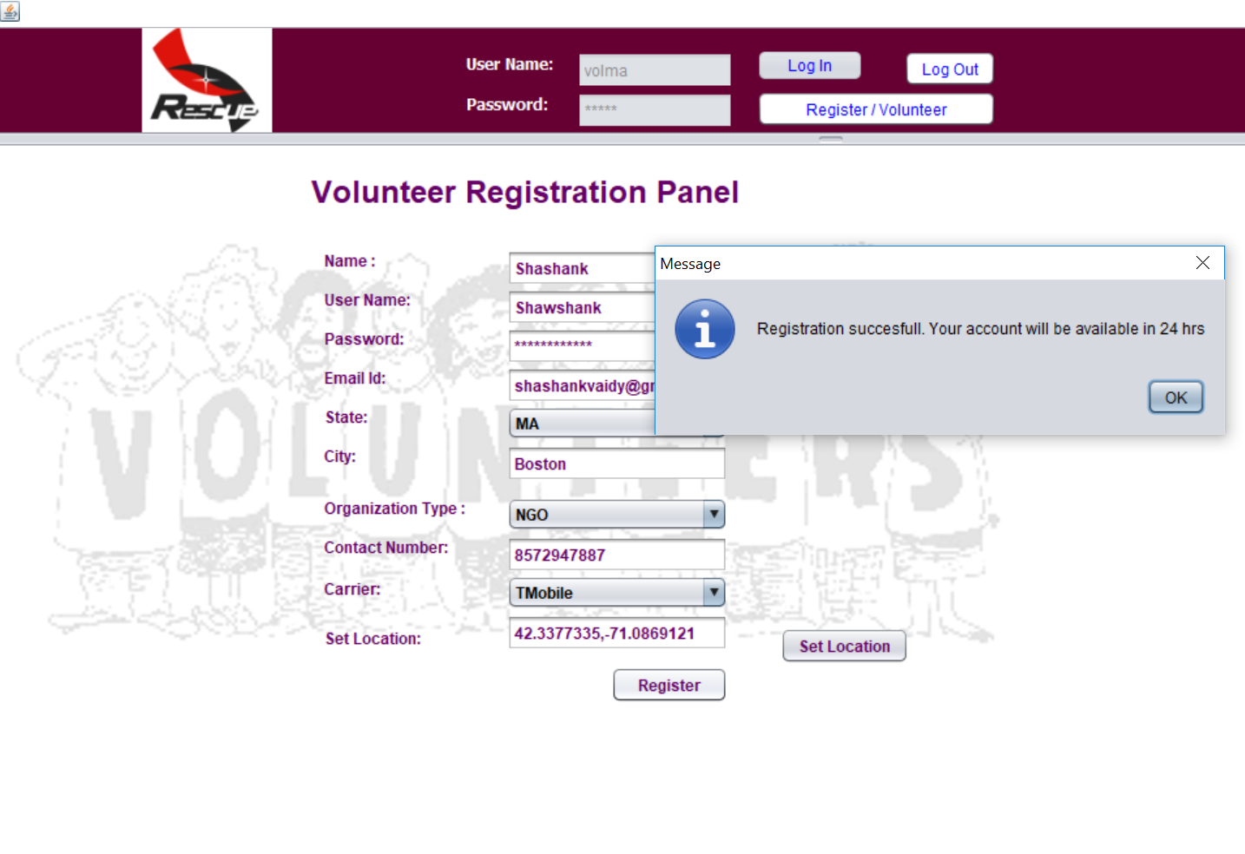
VOLUNTEER REGISTRATION SUCCESSFUL

Slide 17
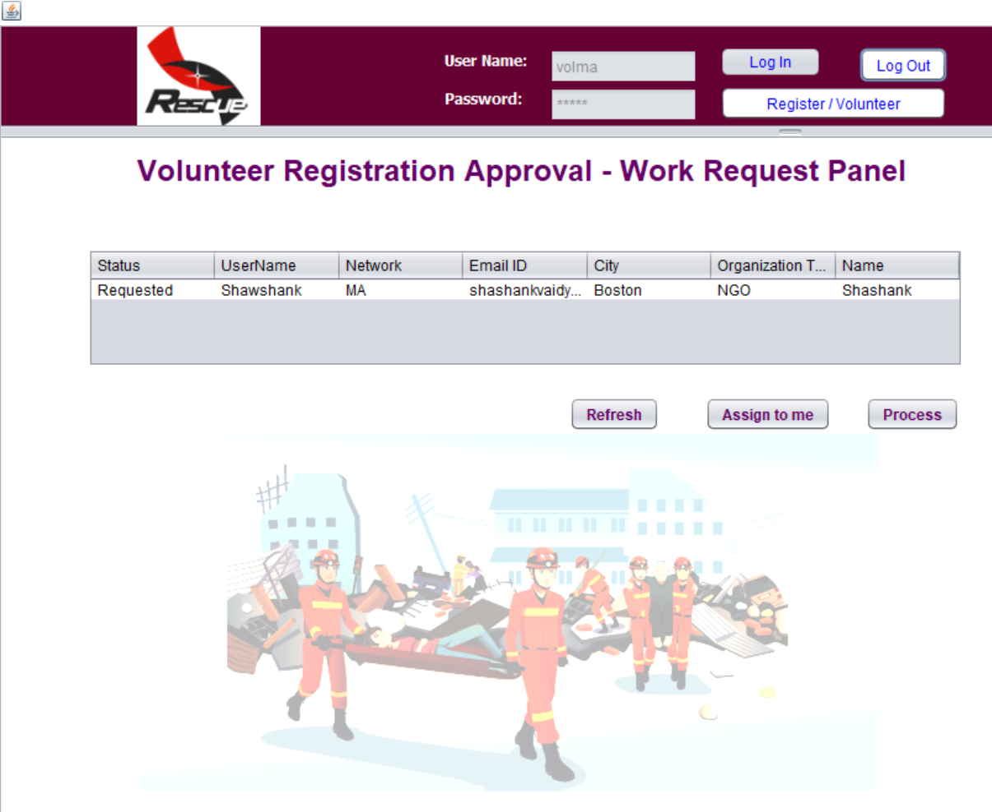
WORK REQUEST TO APPROVE ACCESS TO NEWLY REGISTERD VOLUNTEER

Slide 18

REQUEST APPROVED BY ADMIN – STATUS COMPLETED

Slide 19
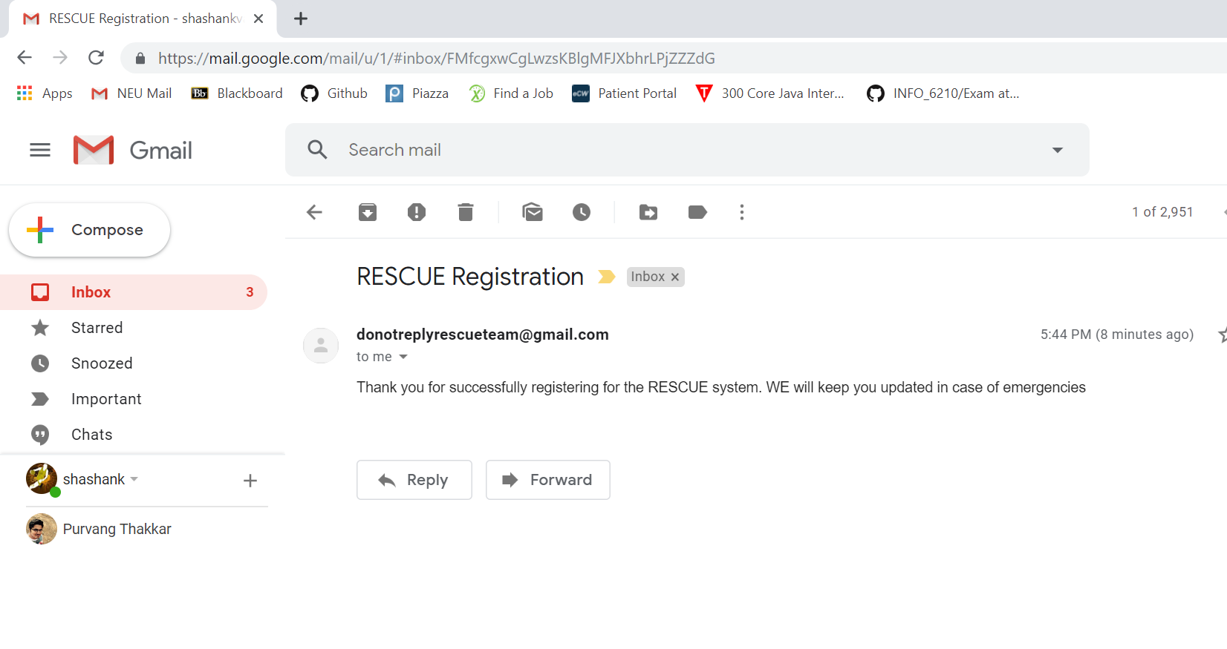
EMAIL CONFIRMATION FROM RESCUE TEAM

Slide 20
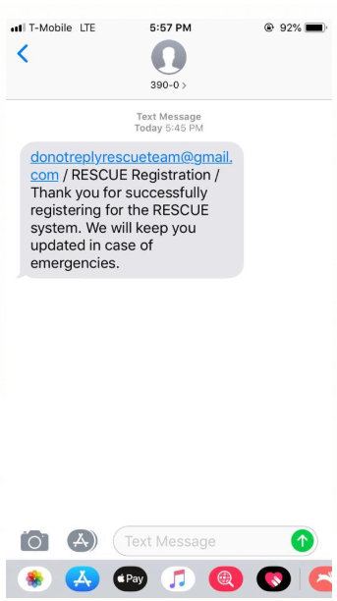
TEXT CONFIRMATION FROM RESCUE TEAM

Slide 21
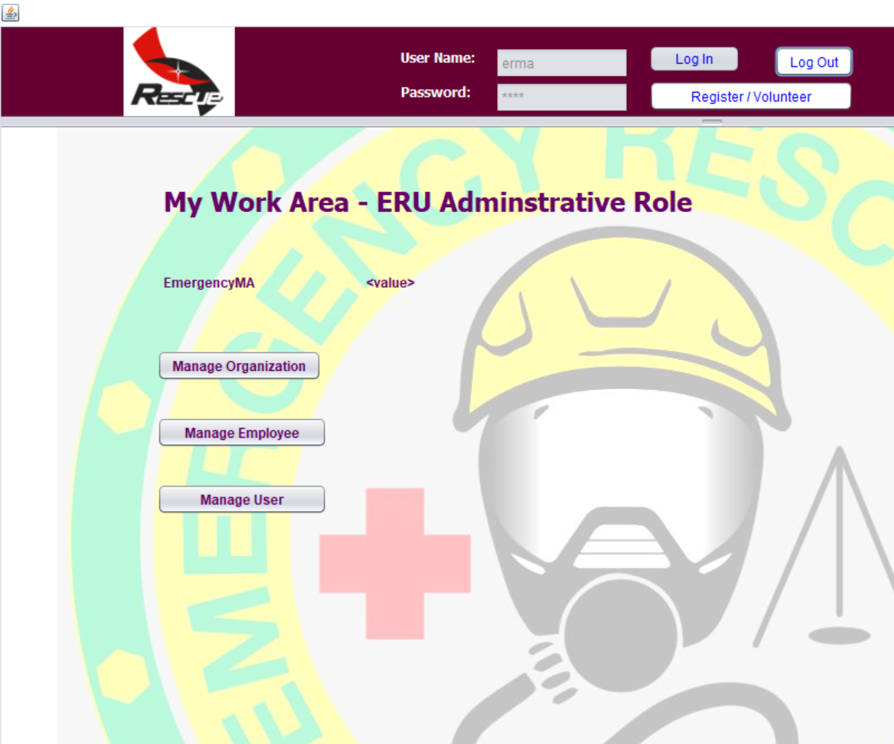
EMERGENCY RESOURCE UNIT ADMIN PAGE

Slide 22
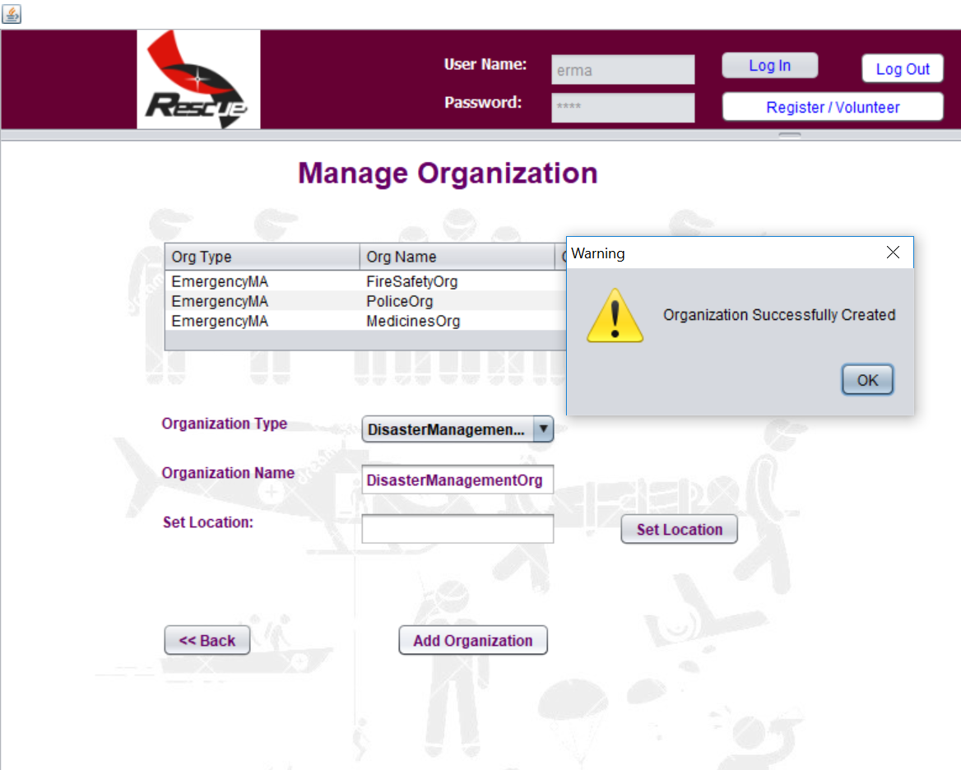
REPORTING AGENCY MANAGE ORGANIZATION

Slide 23
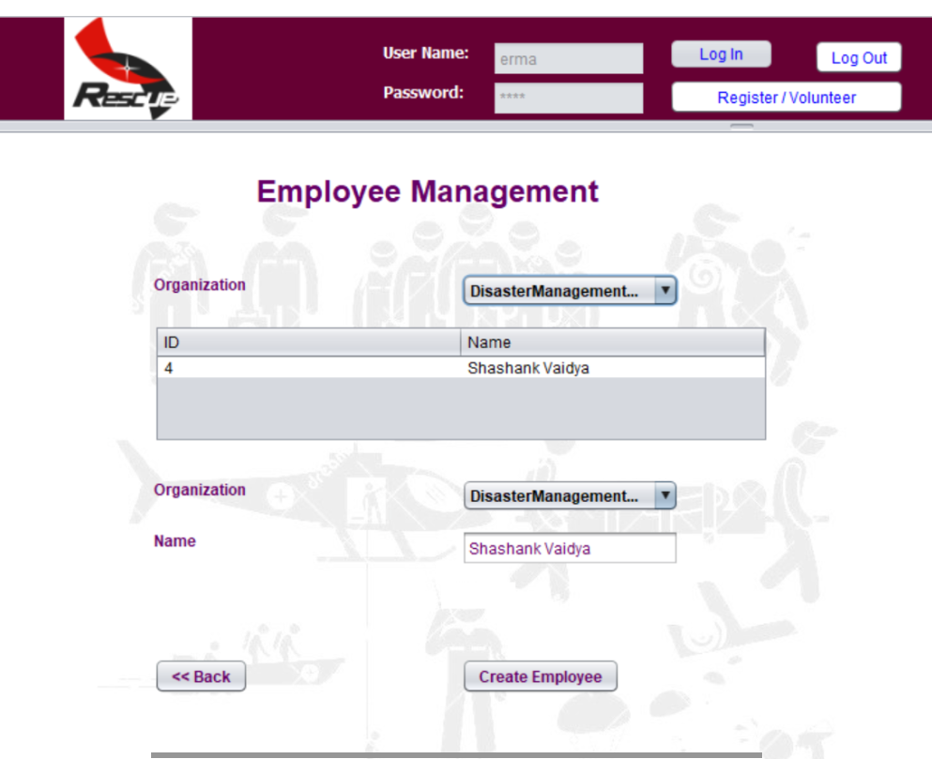
REPORTING AGENCY EMPLOYEE MANAGEMENT

Slide 24
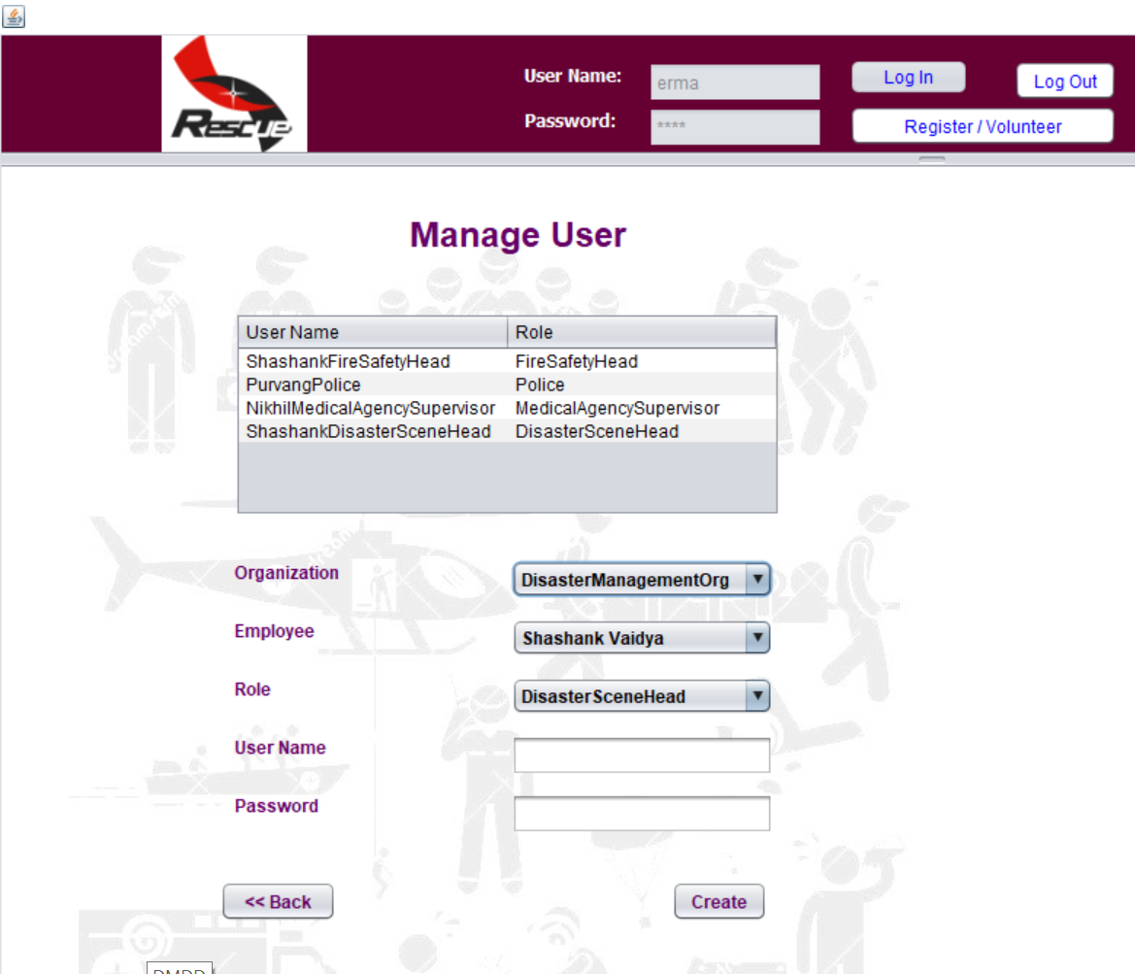
ERU – MANAGE USER

Slide 25
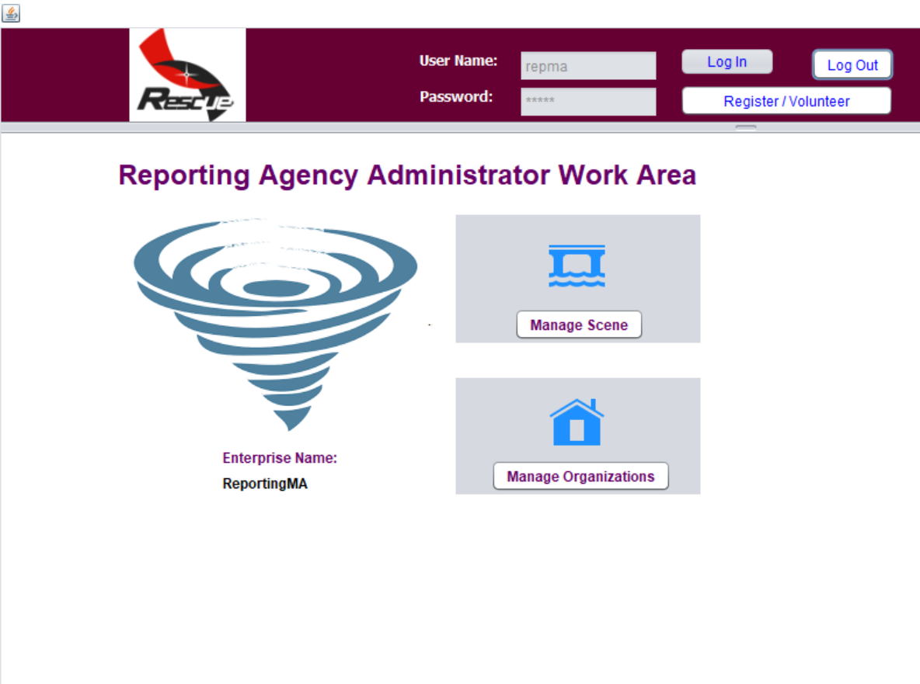
REPORTING AGENCY ADMIN PAGE

Slide 26
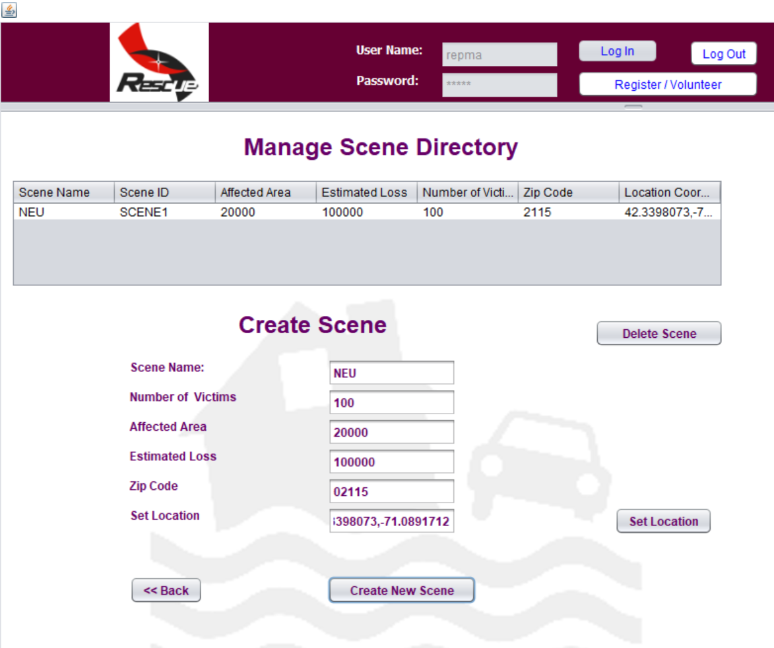
CREATE SCENE WHERE EVENT OCCURS

Slide 27
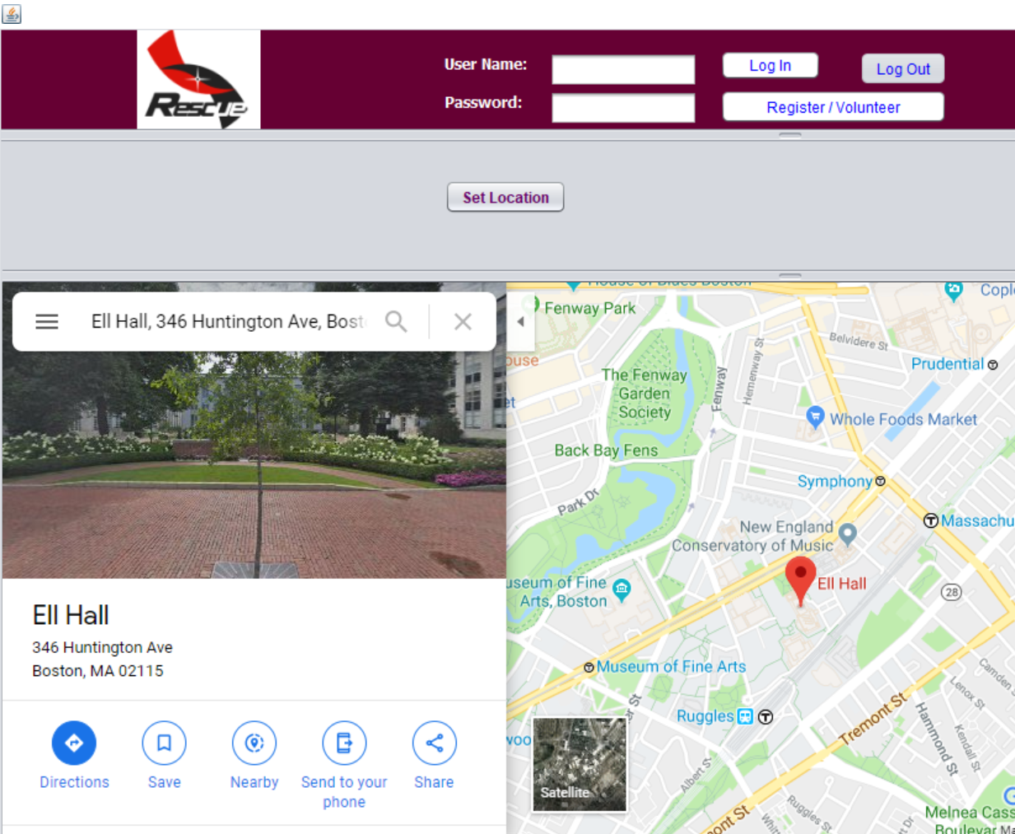
DISASTER SCENE CREATED WITH LOCATION

Slide 28
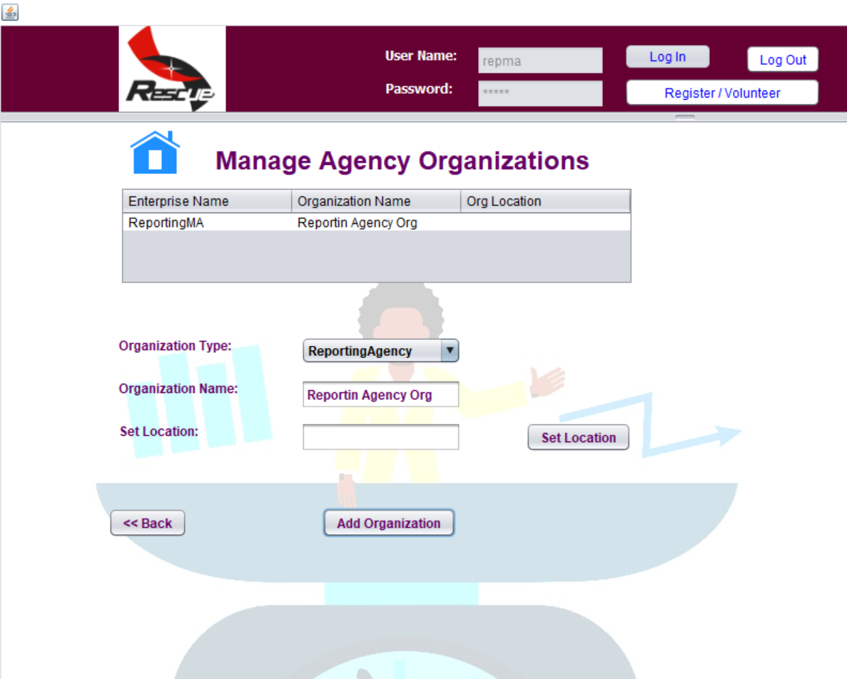
REPORTING AGENCY MANAGE AGENCIES

Slide 29
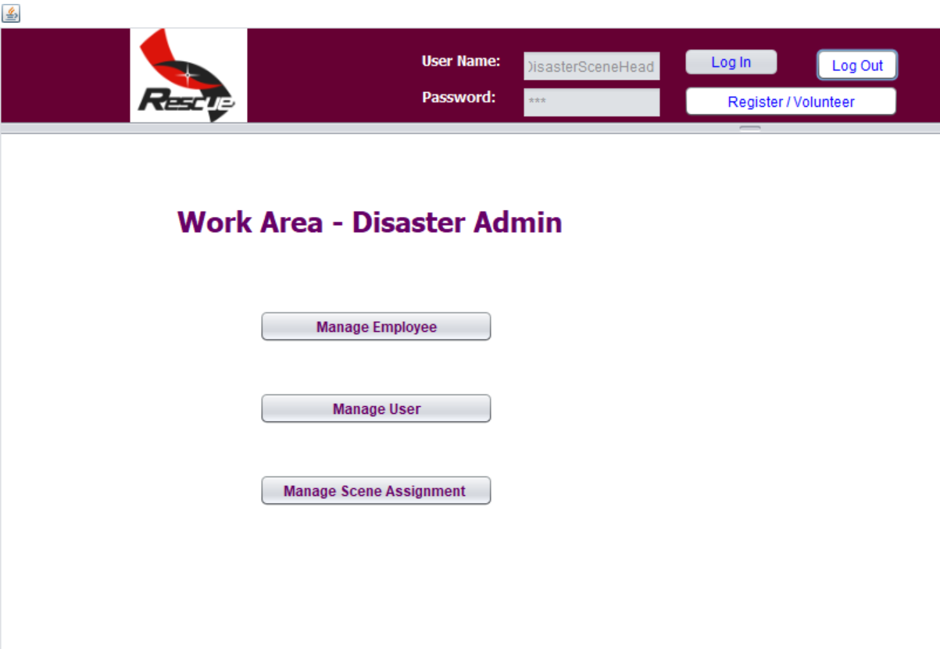
DISASTER ADMIN PAGE

Slide 30
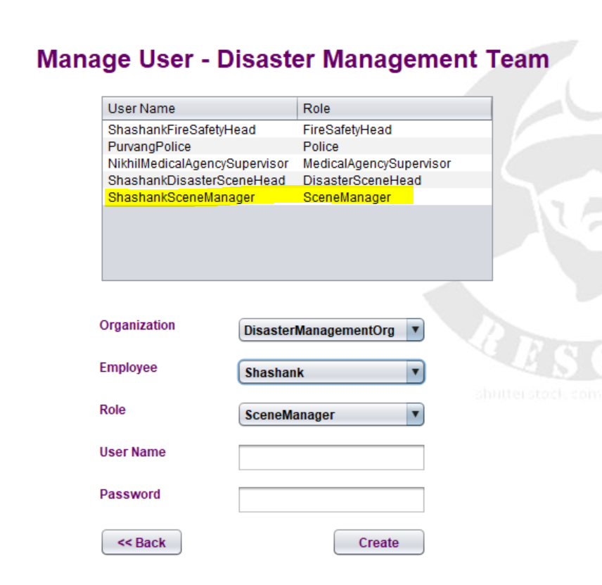
DISASTER MANAGEMENT TEAM MANAGE USER

Slide 31
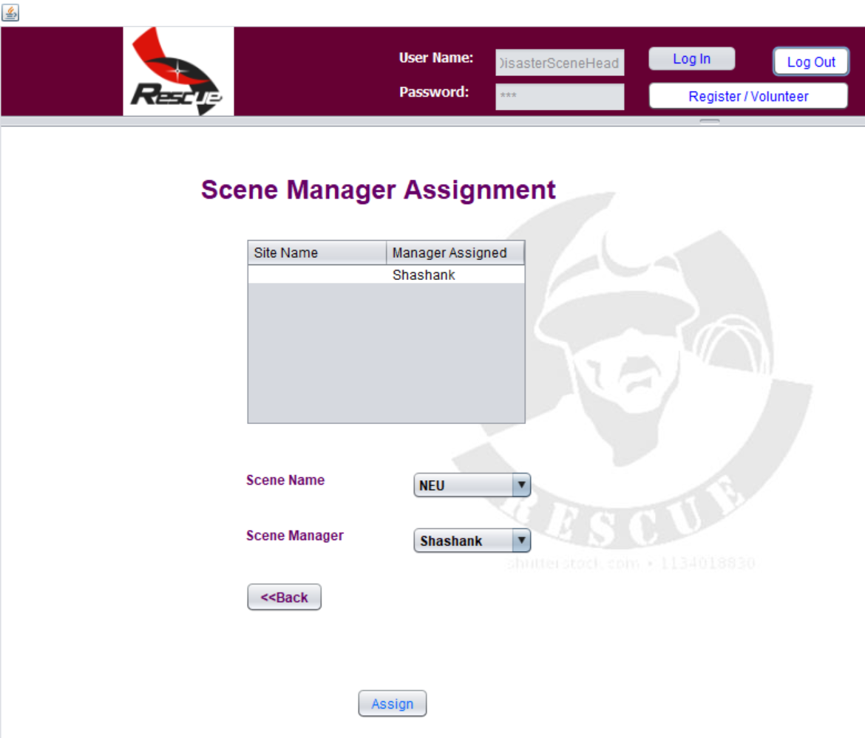
SCENE MANAGER ASSIGNMENT

Slide 32
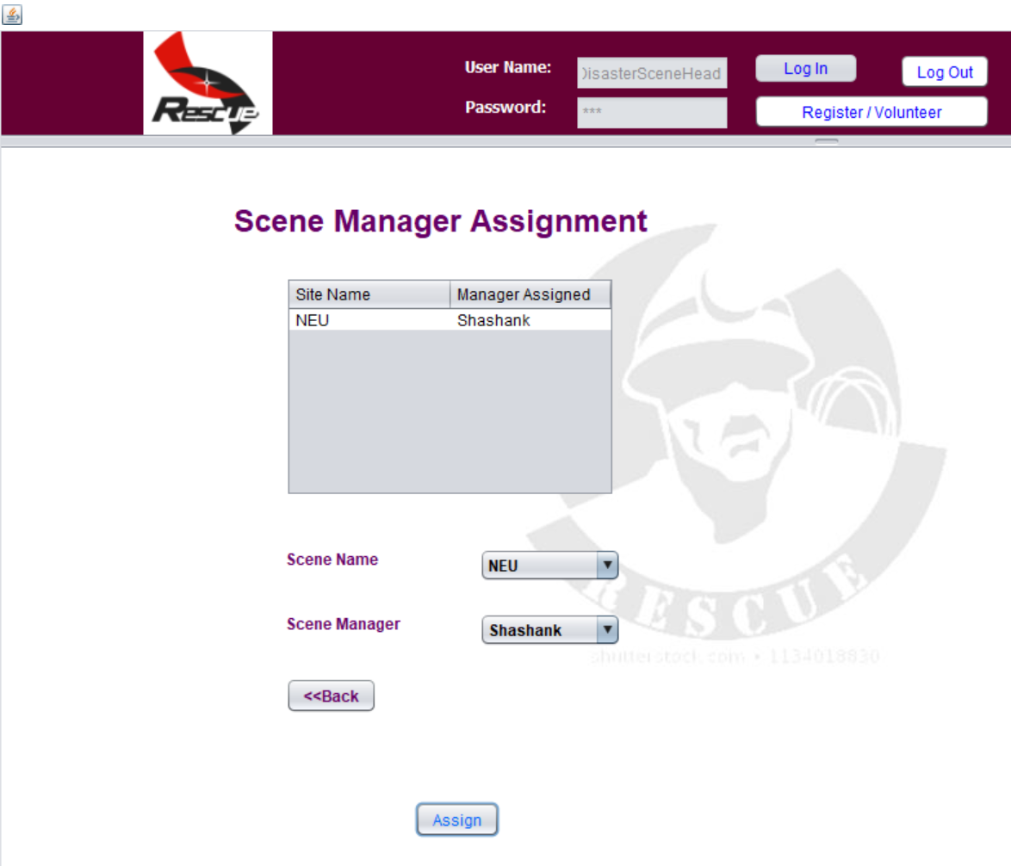
SCENE ASSIGNED TO SCENE MANAGER

Slide 33
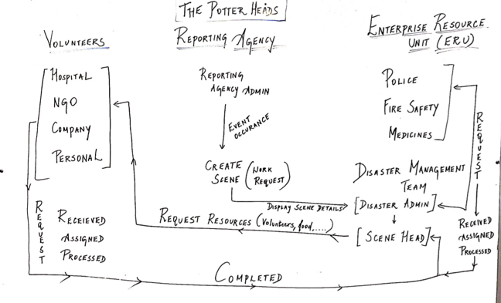
REQUEST FLOW

Slide 34
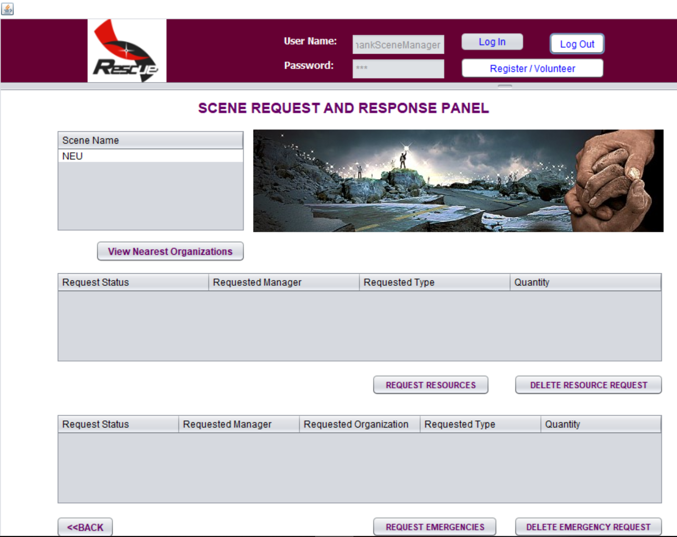
SCENE MANAGER PAGE
1
1
2
2
3
3

Slide 35
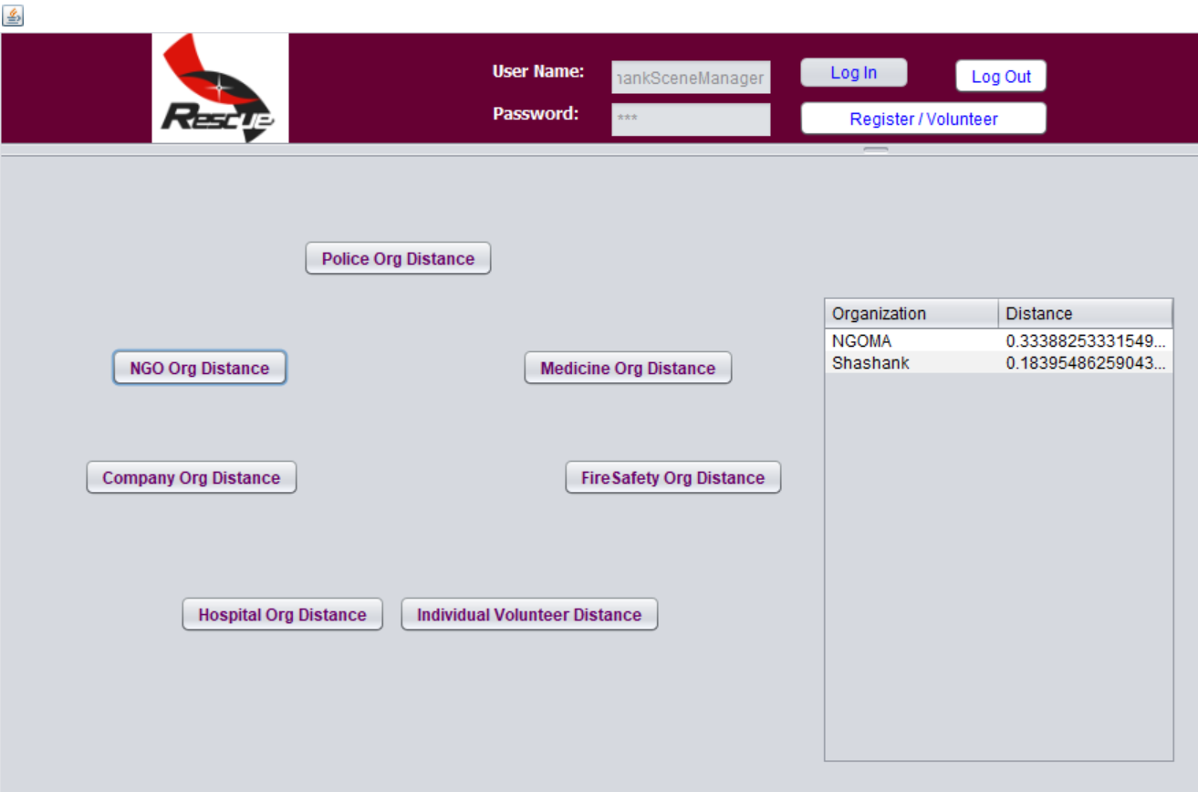
1. VIEW NEAREST ORGANIZATION BASED ON INPUT FROM REGISTERED LOCATION OF ORGANIZATIONS

Slide 36
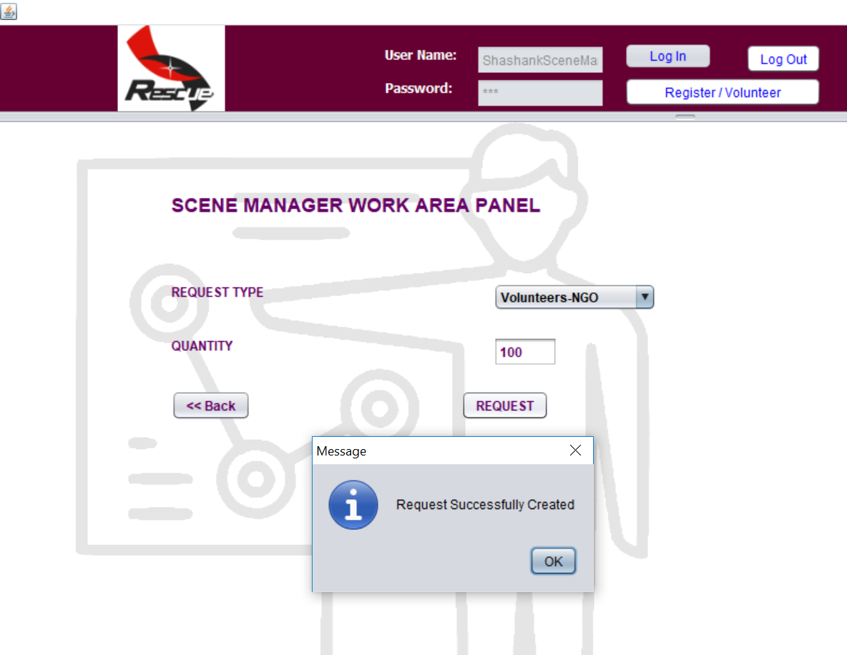
2. REQUEST FOR RESOURCES FROM VOLUNTARY ENTERPRISE

Slide 37
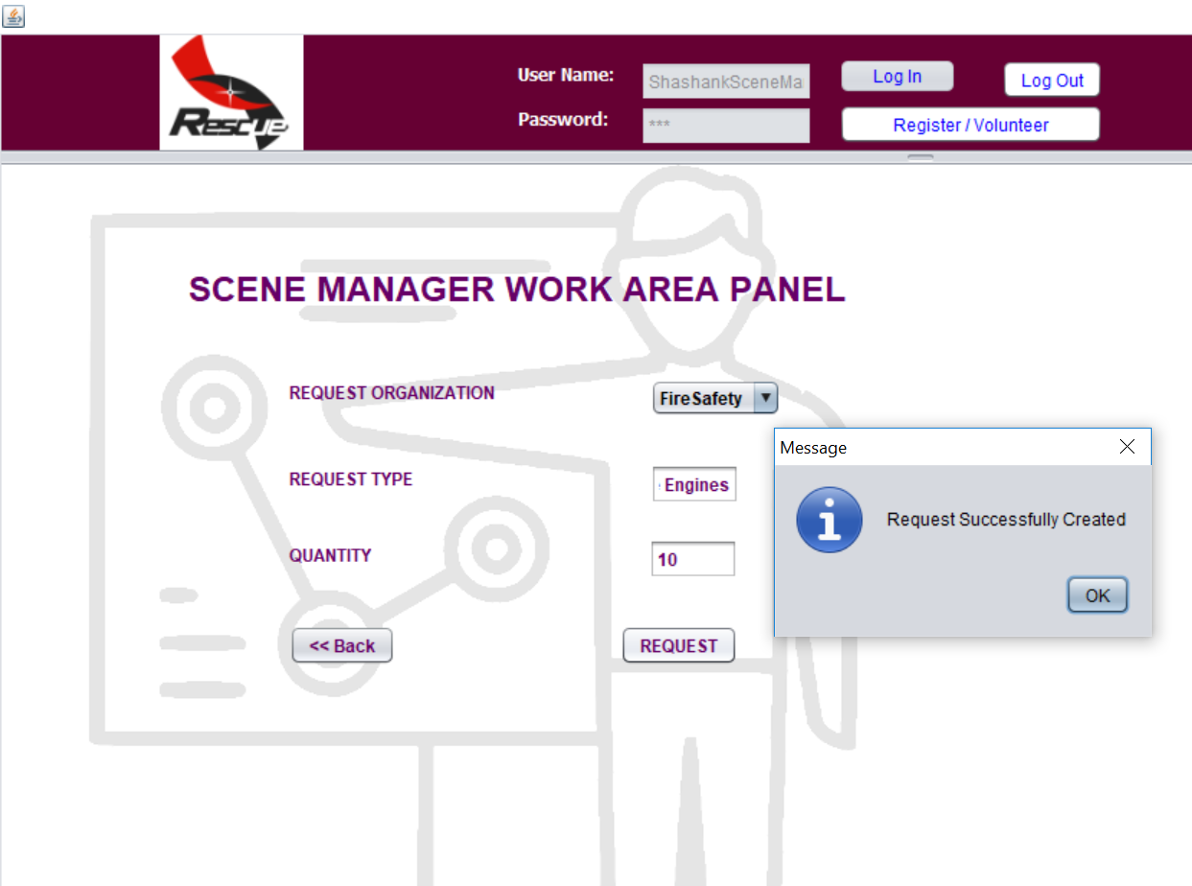
3. REQUEST FROM EMERGENCY RESOURCE UNIT ENTERPRISE

Slide 38
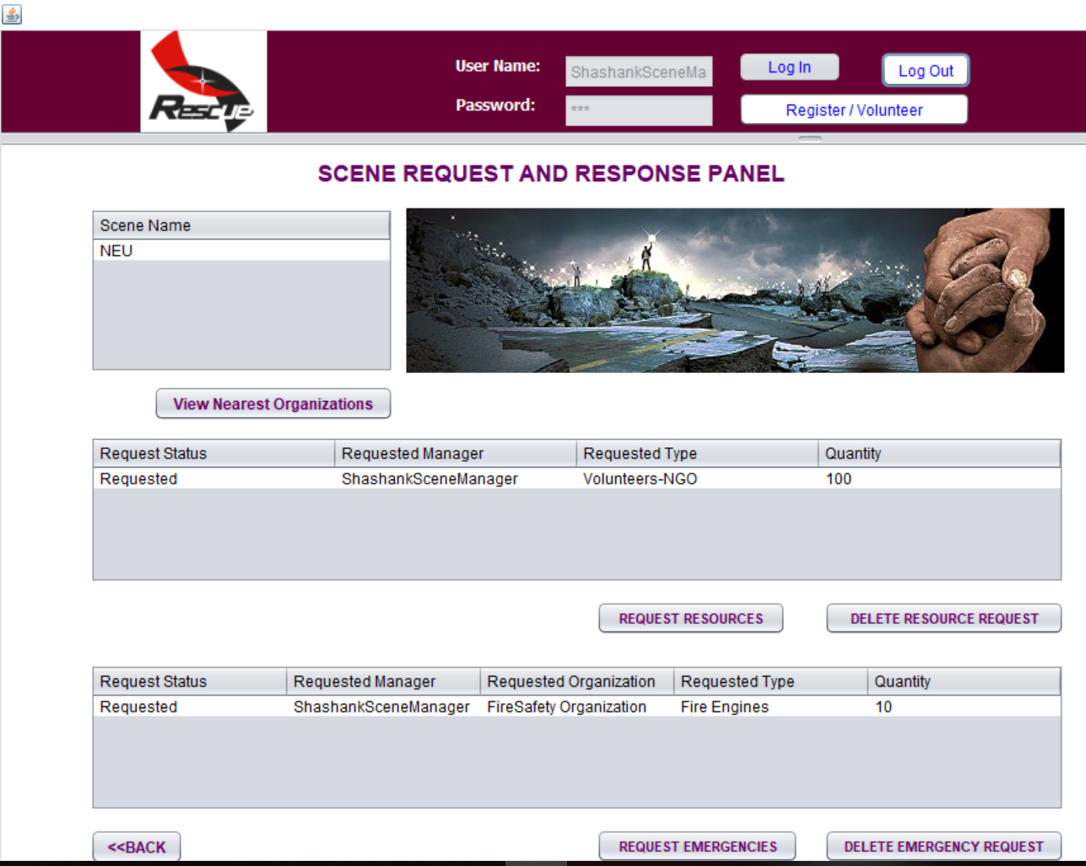
REQUEST STATUS “REQUESTED”

Slide 39
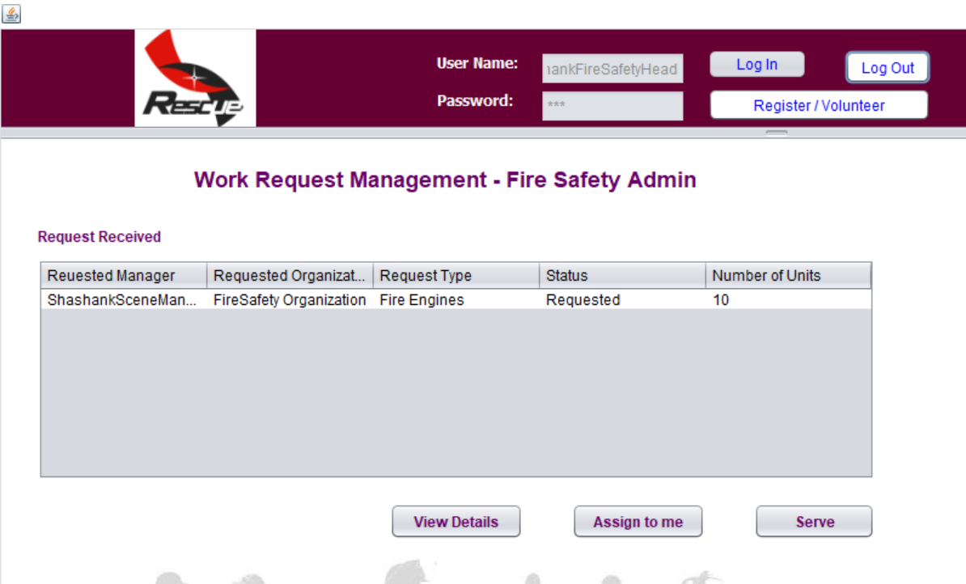
FIRE SAFETY HEAD WORK REQUEST RECEIVED
1

Slide 40
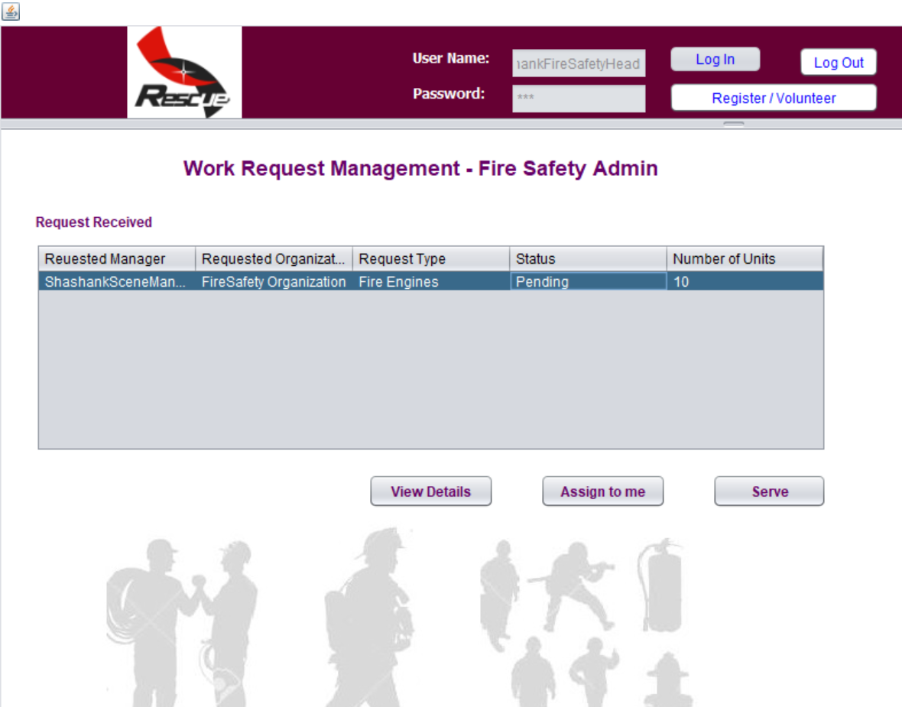
1. STATUS “PENDING” POST ASSIGNMENT
2

Slide 41
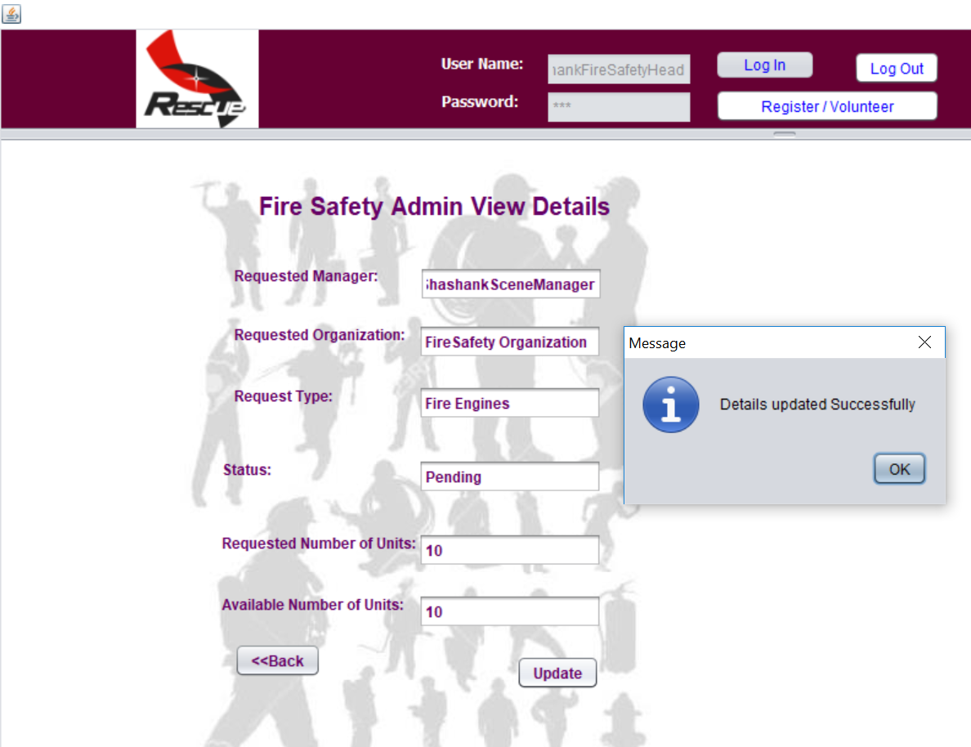
FIRE SAFETY HEAD VIEW REQUEST

Slide 42
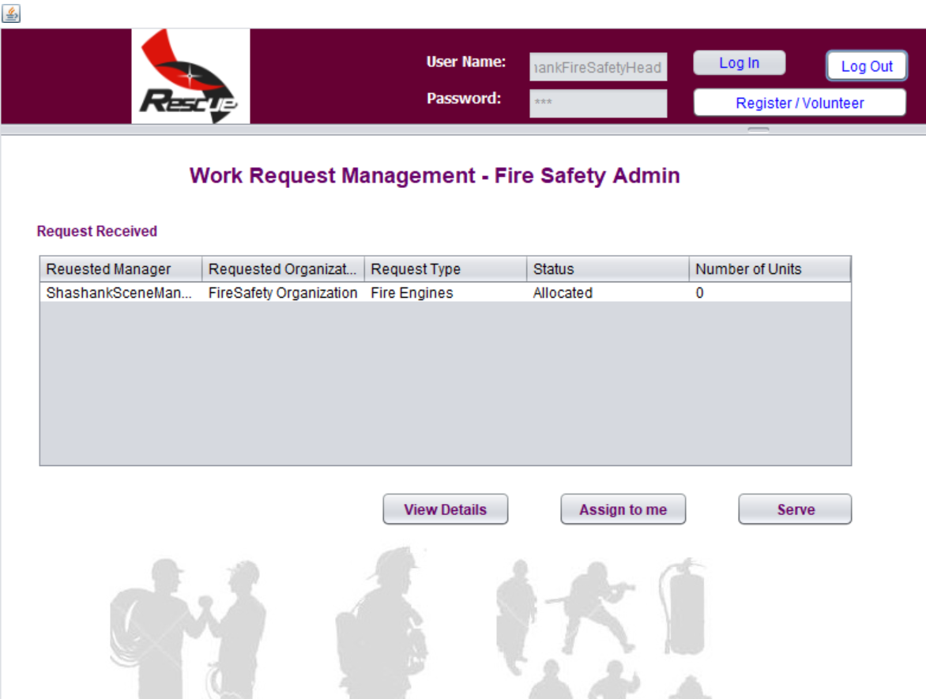
ERU RESOURCES ALLOCATED
3

Slide 43
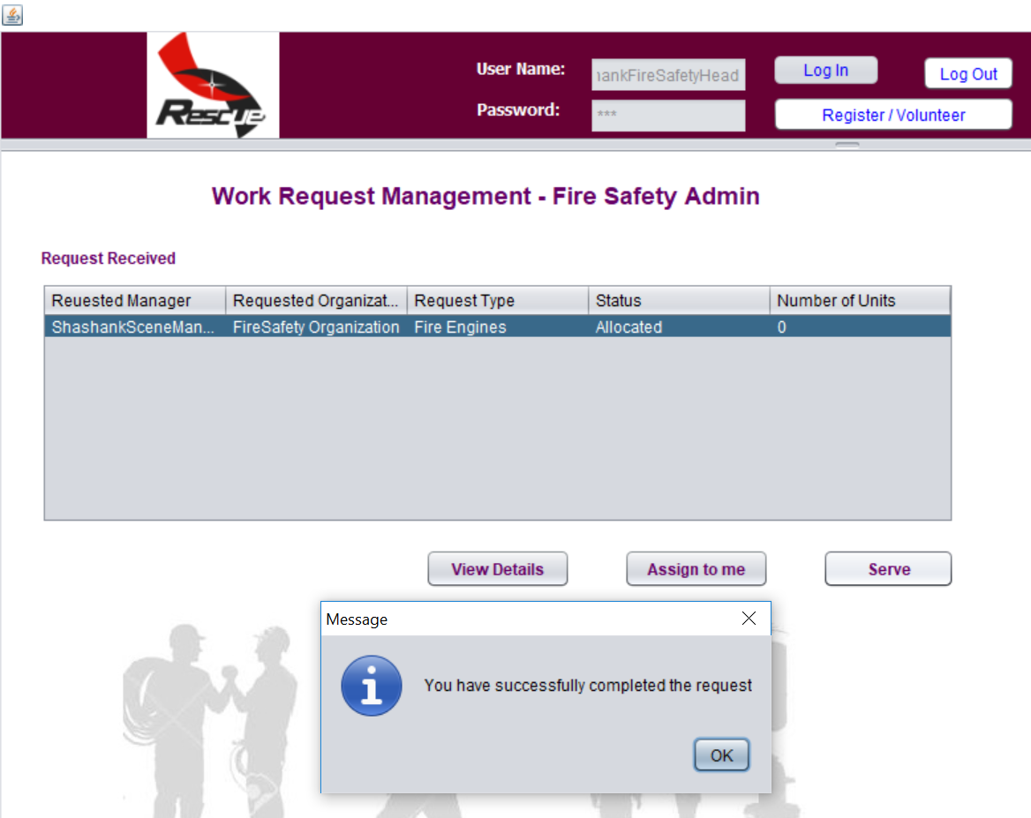
SERVING THE REQUEST

Slide 44
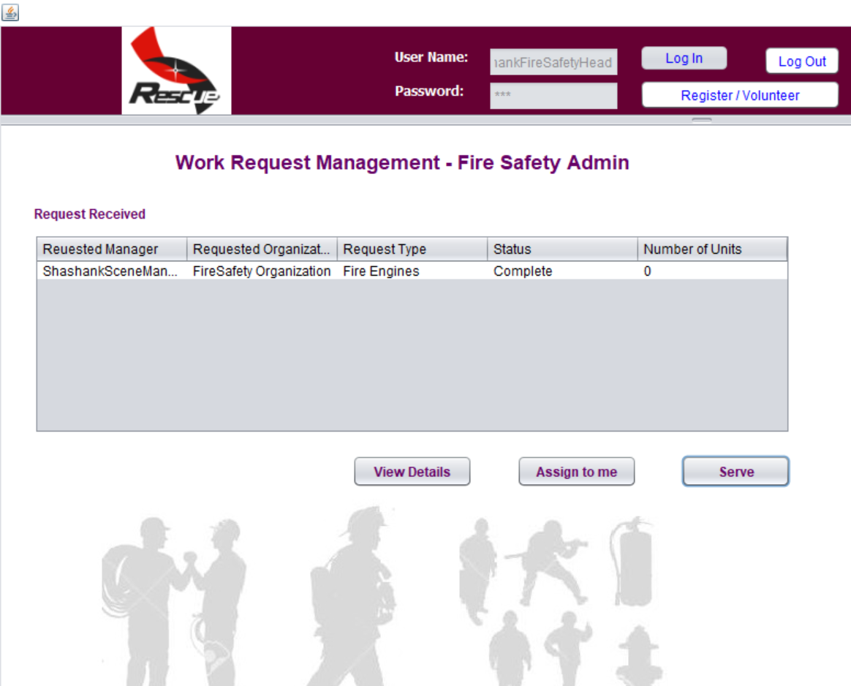
WORK REQUEST FROM SCENE MANAGER IS COMPLETE

Slide 45
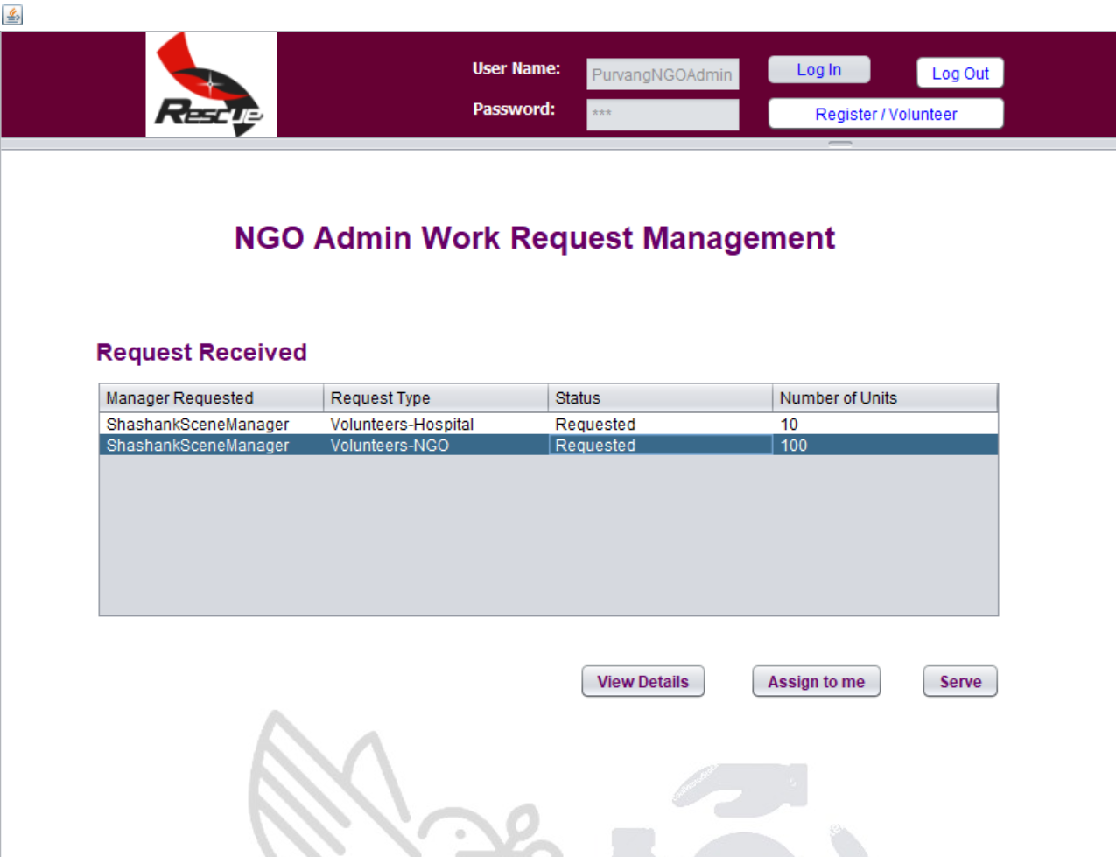
REQUEST FROM SCENE MANAGER TO NGO ADMIN
1

Slide 46
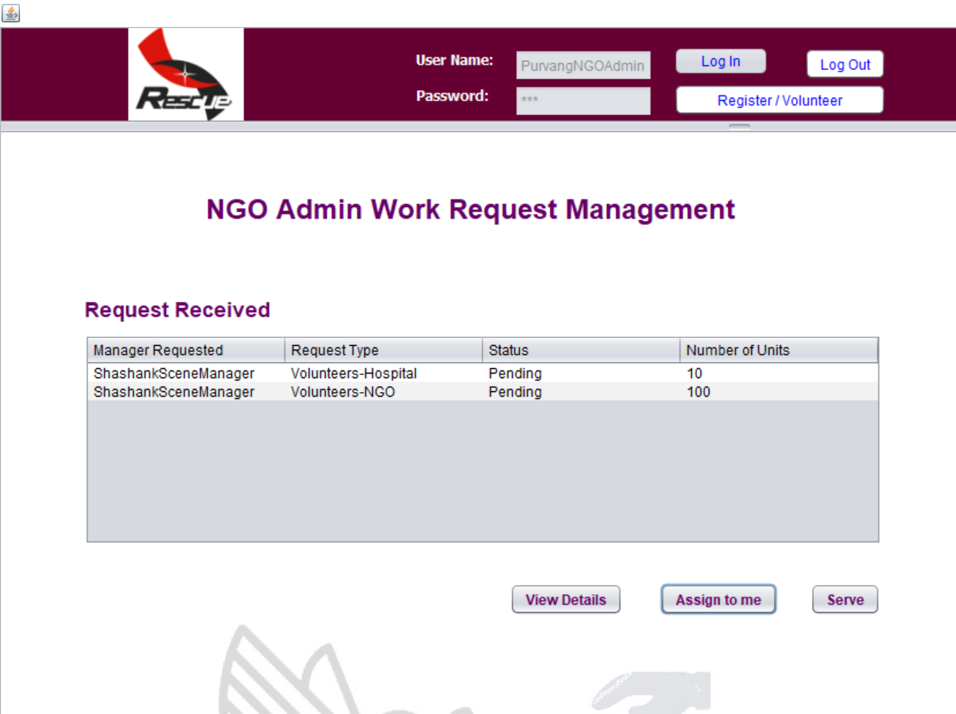
PENDING REQUEST
2

Slide 47
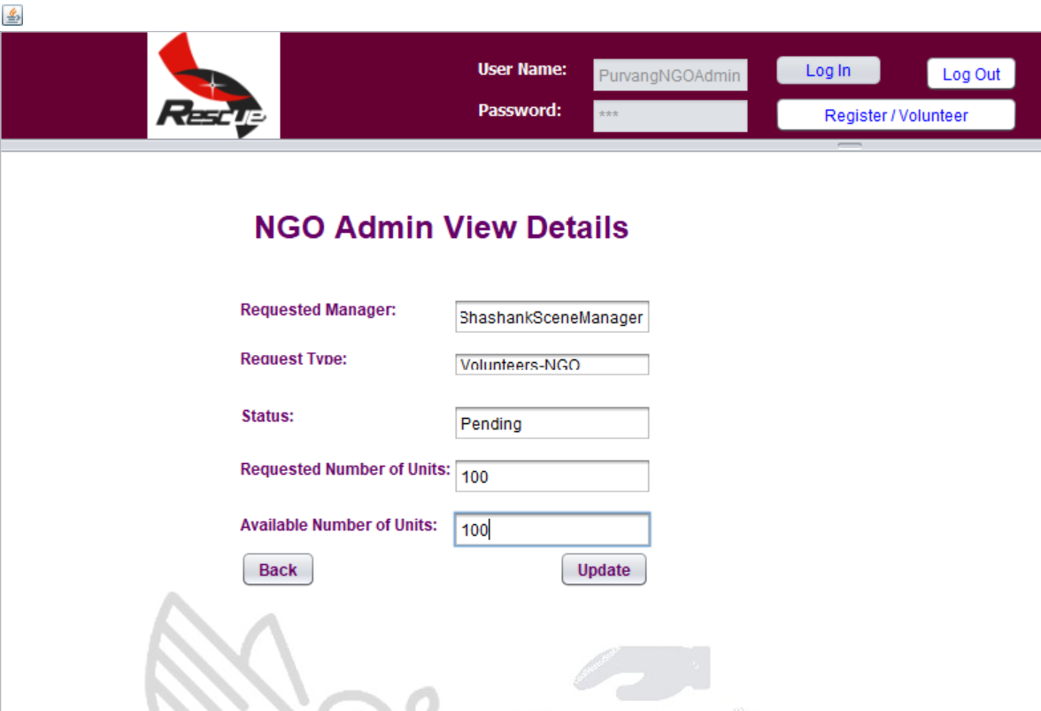
NGO ADMIN VIEW REQUEST AND UPDATE

Slide 48
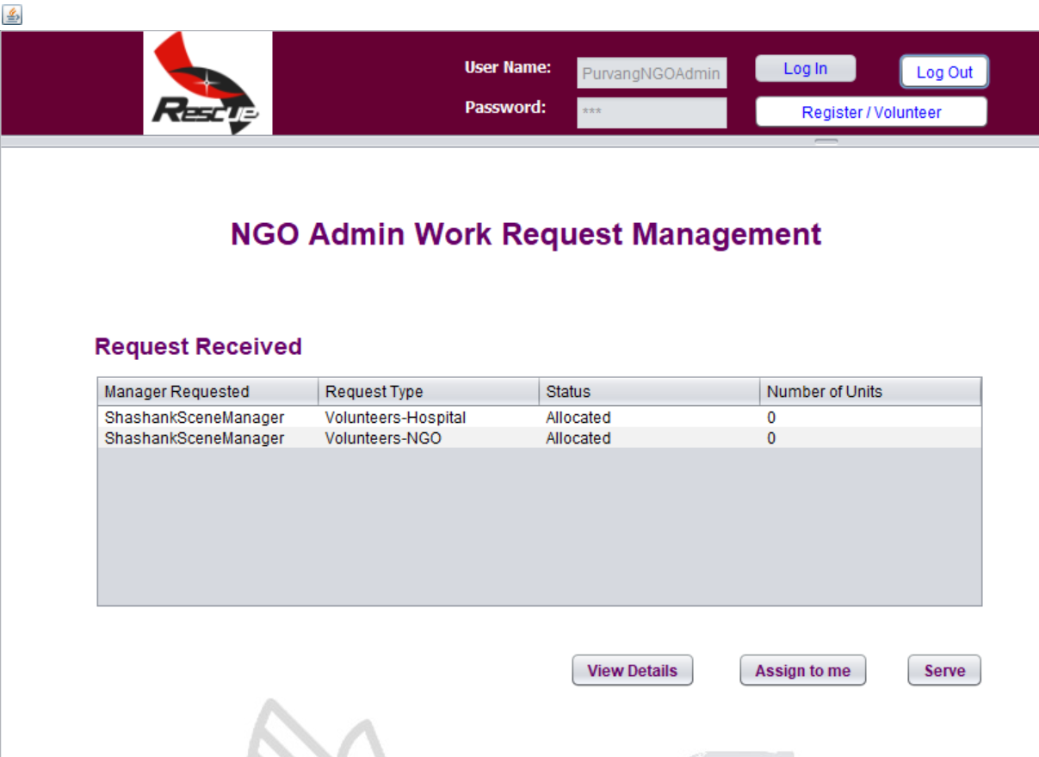
STATUS ALLOCATED
3

Slide 49
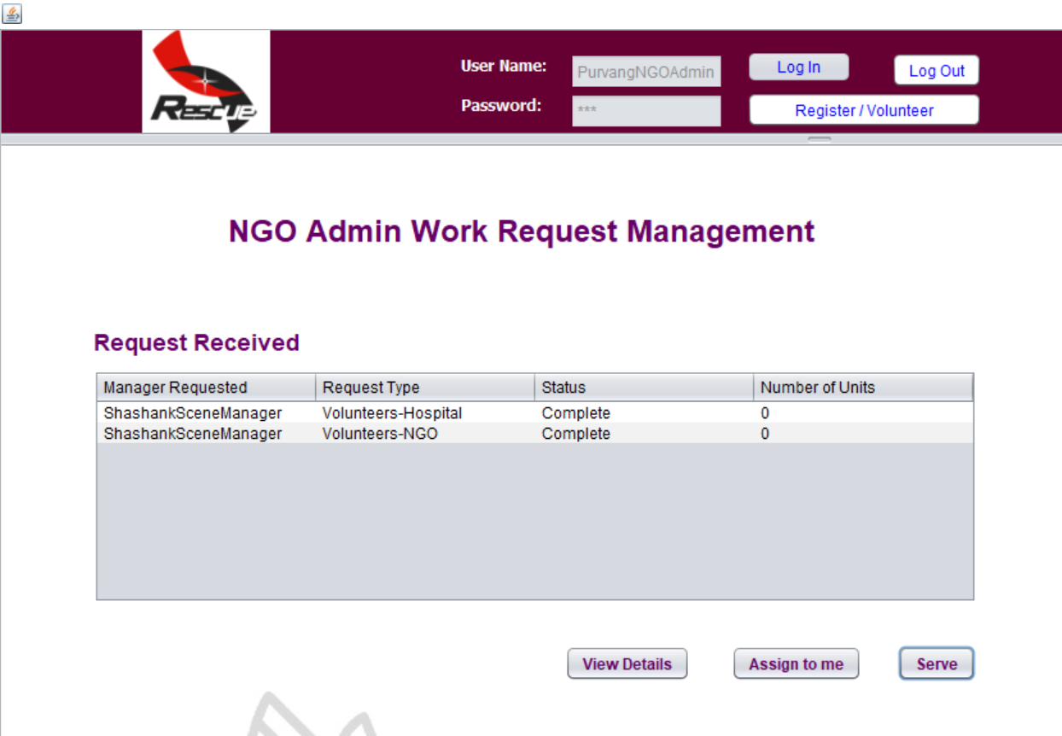
WORK REQUEST FROM SCENE MANAGER TO NGO ADMIN STATUS IS COMPELTE

Slide 50
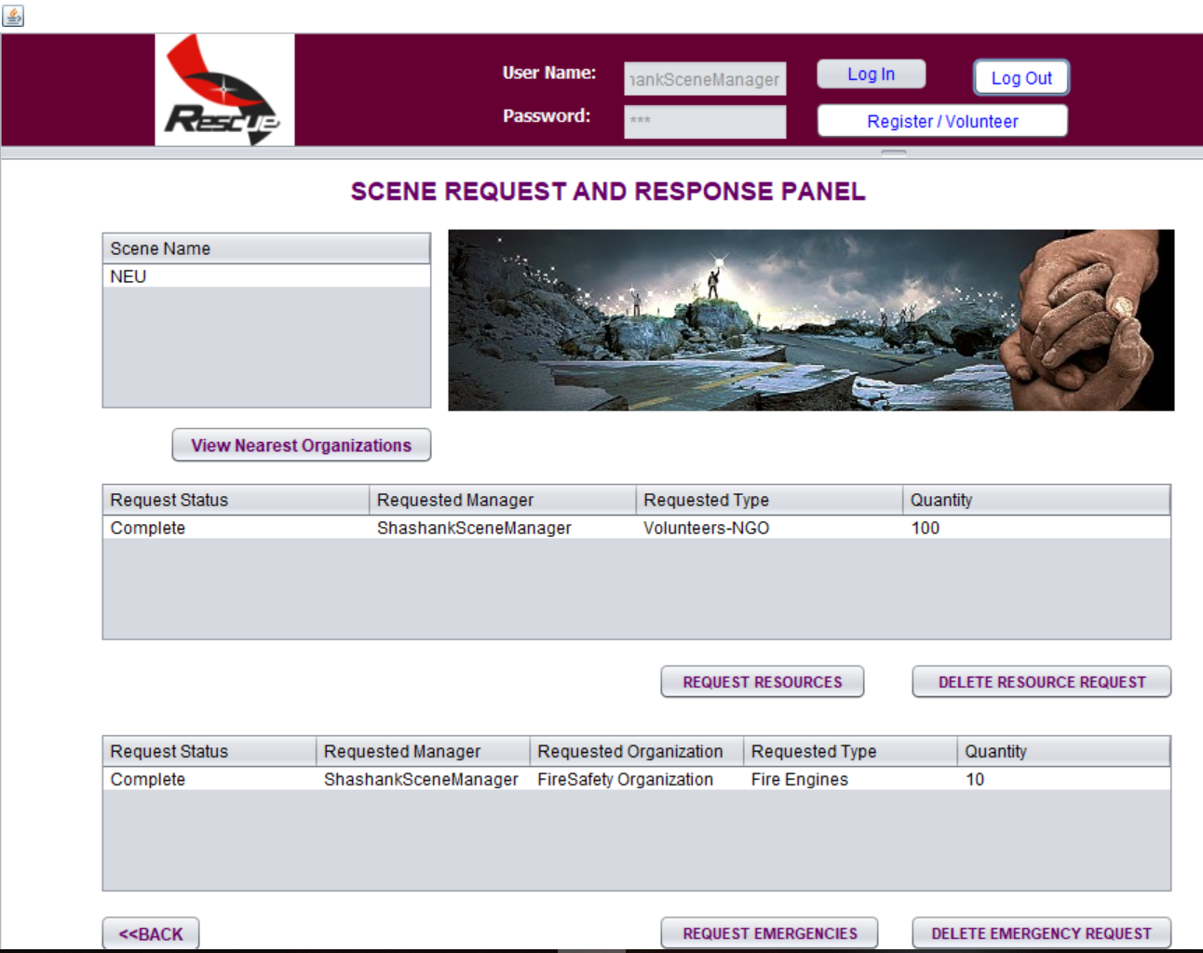
FINAL REQUEST COMPLETE BETWEEN ALL ENTERPRISES

Slide 51
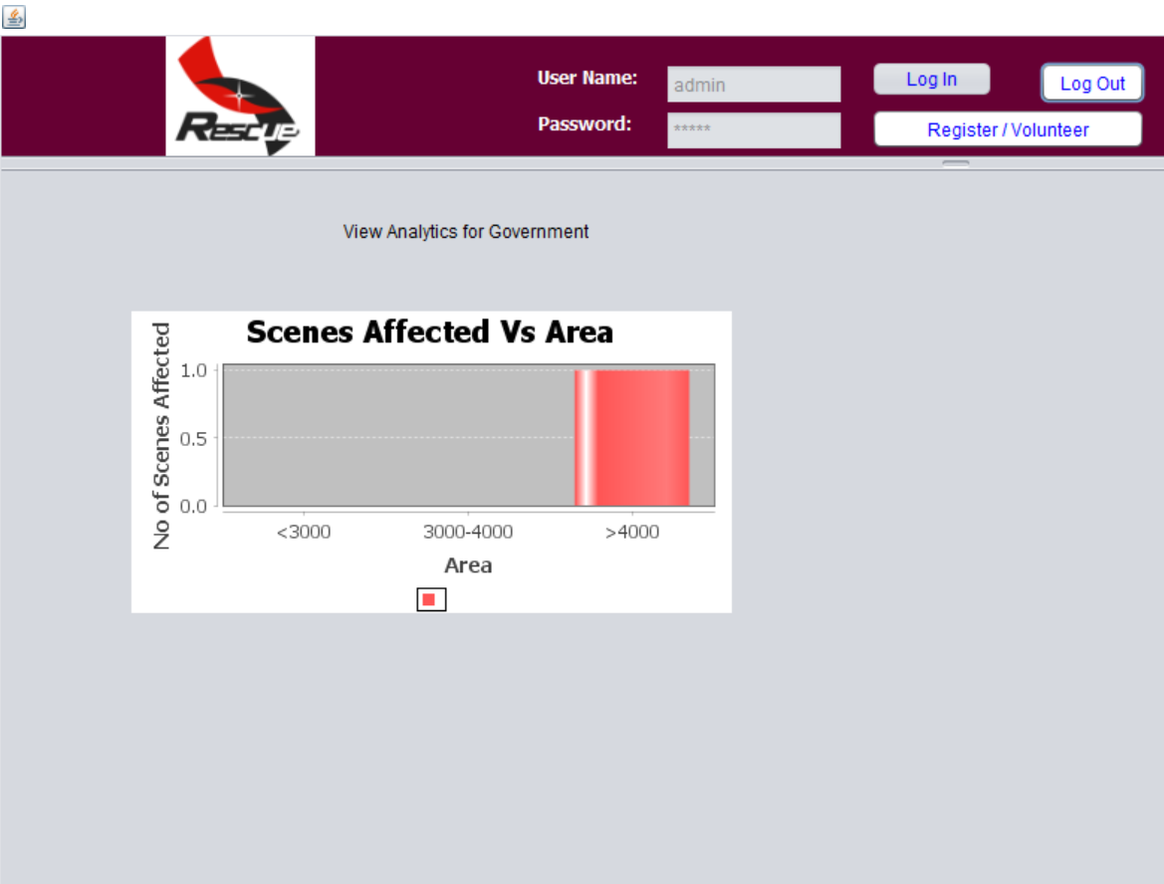
ANALYTICS PAGE

Slide 52
THANK YOU ☺

